Slide 1

MindScribe
An AI-Powered Emotional Journal Dashboard.
GitHub

Slide 2
Project Overview.
What is MindScribe?
MindScribe is a full-stack web application that helps users record and analyze their daily thoughts using AI-powered sentiment analysis. The goal is to promote mental wellness by providing
Insights into emotional trends over time.

Slide 3






Purpose, Introduction & Tech Stack.
Purpose:
Mental well-being is an important yet often overlooked aspect of life. MindScribe aims to simplify emotional tracking by allowing users to express their thoughts and automatically receive feedback on their emotional tone. This promotes self-awareness, reflection, and emotional growth.
Introduction:
When users log their daily entries, the system applies Natural Language Processing (NLP) SpaCy models to detect the emotional tone (Positive, Neutral, or Negative).
These insights are visualized through mood charts, allowing users to track changes in their mental state over time.
The goal is not just journaling — it’s understanding how emotions evolve, helping users identify triggers, patterns, and progress.
Tech Stack:
Frontend: React.js for dynamic and interactive UI
Styling: Tailwind CSS for responsive layouts
Backend: Django REST Framework for robust API endpoints
Database: PostgreSQL for fast and lightweight data storage
AI/ML: Sentiment analysis using pretrained SpaCy models
Hosting: Render (backend and frontend)

Slide 4
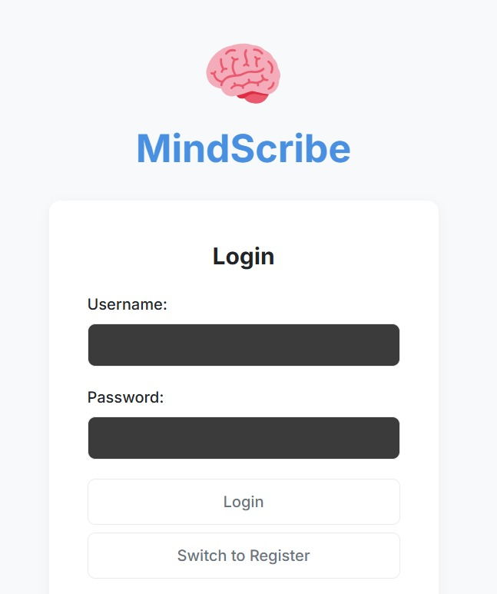
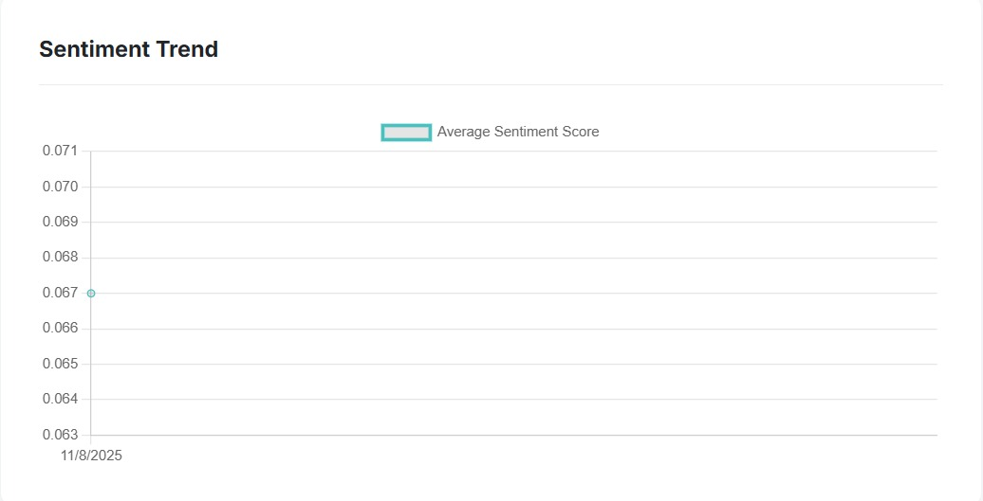
Working of the Website.
User Flow:
User Login / Sign Up: Users create an account and securely log in to access their personalized dashboard.
Journal Entry: The user writes about their day, feelings, or events in a simple text box.
Backend Processing: When the entry is submitted, it’s sent to the Django backend, where an NLP (SpaCy) model evaluates sentiment and confidence level.
Storage: Each journal entry, along with its sentiment score, is stored in the database for visualization.
Interface Description:
A clean dashboard displaying total entries, sentiment distribution, and quick access to new journal creation.
The interface emphasizes simplicity and emotional expression.

Slide 5
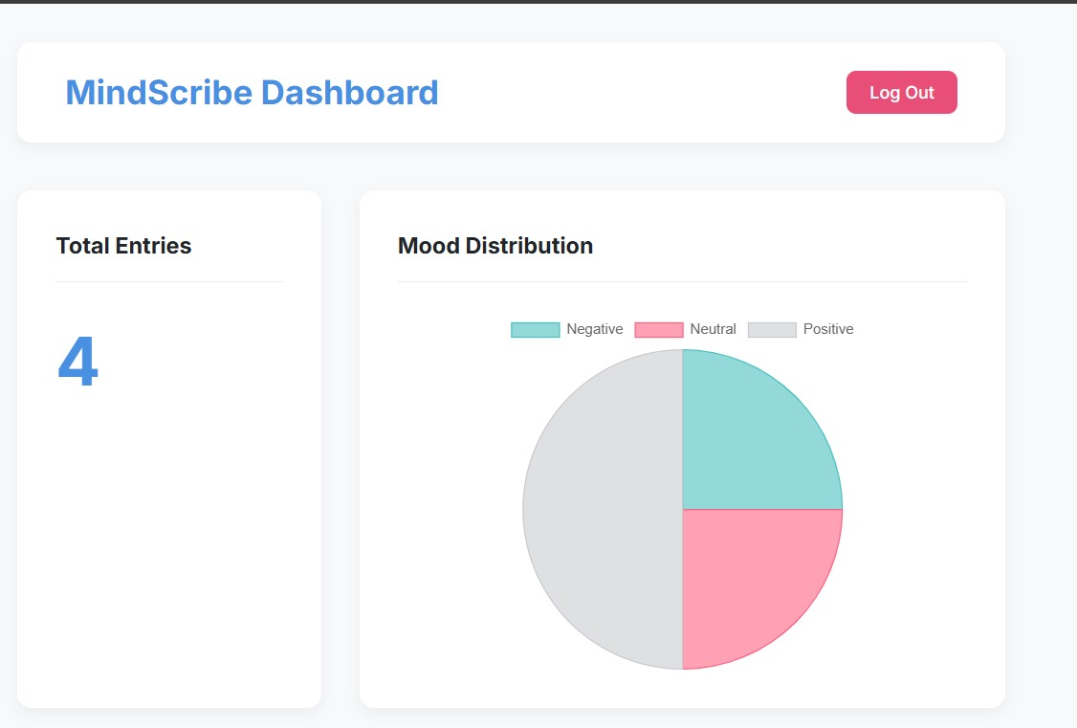
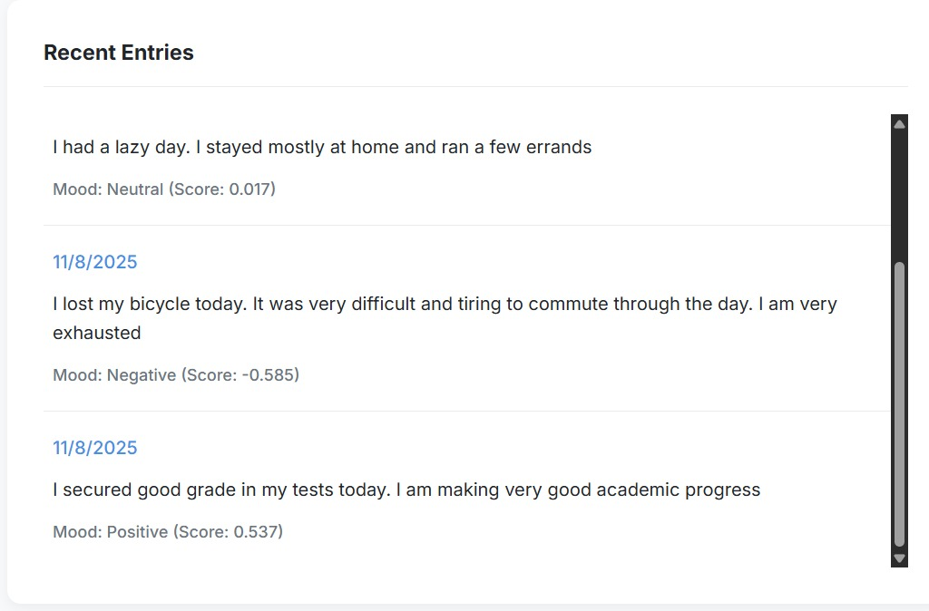
Working of the Website.
Features & Functionality:
Sentiment Trend Visualization:
Displays an interactive line chart that shows how the user’s emotional state changes day-by-day.
Mood Distribution Chart:
A pie chart categorizes all entries into Positive, Negative, or Neutral, helping users understand their emotional balance.
Recent Entries:
Shows a chronological list of journal logs, each labeled with its sentiment and confidence score.
Responsive Design:
The dashboard automatically adjusts to different screen sizes, providing a consistent experience across devices.
Technical Flow:
React components fetch sentiment data via REST API.
Data is processed and passed to chart libraries for visualization.
Any new journal instantly updates the dashboard through re-rendering.

Slide 6
Conclusion.
Summary:
MindScribe combines AI technology with emotional well-being to create a platform that encourages self-reflection and mindfulness.
By integrating machine learning for text sentiment analysis, it bridges the gap between technology and mental health.
Key Achievements:
Fully functional AI-integrated journaling system.
Clean and intuitive React interface with live data visualization.
Successfully deployed backend and frontend with seamless communication.
Future Scope:
Integration with Google Authentication for easier user onboarding.
Implementation of voice-to-text journaling using speech recognition.
Addition of daily mood notifications and long-term progress tracking.
Deployment of mobile version using React Native.
Conclusion Statement:
“MindScribe empowers users to understand their emotions through data — turning simple journaling into a journey of emotional awareness and self-improvement.”

